Slide 1
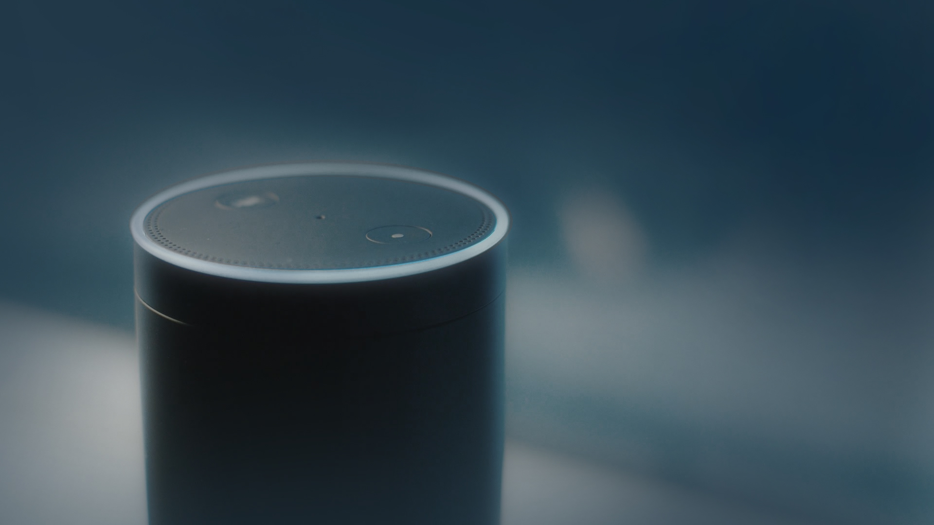

Welcome to Med Assist
Hello
voice assistant

Slide 2
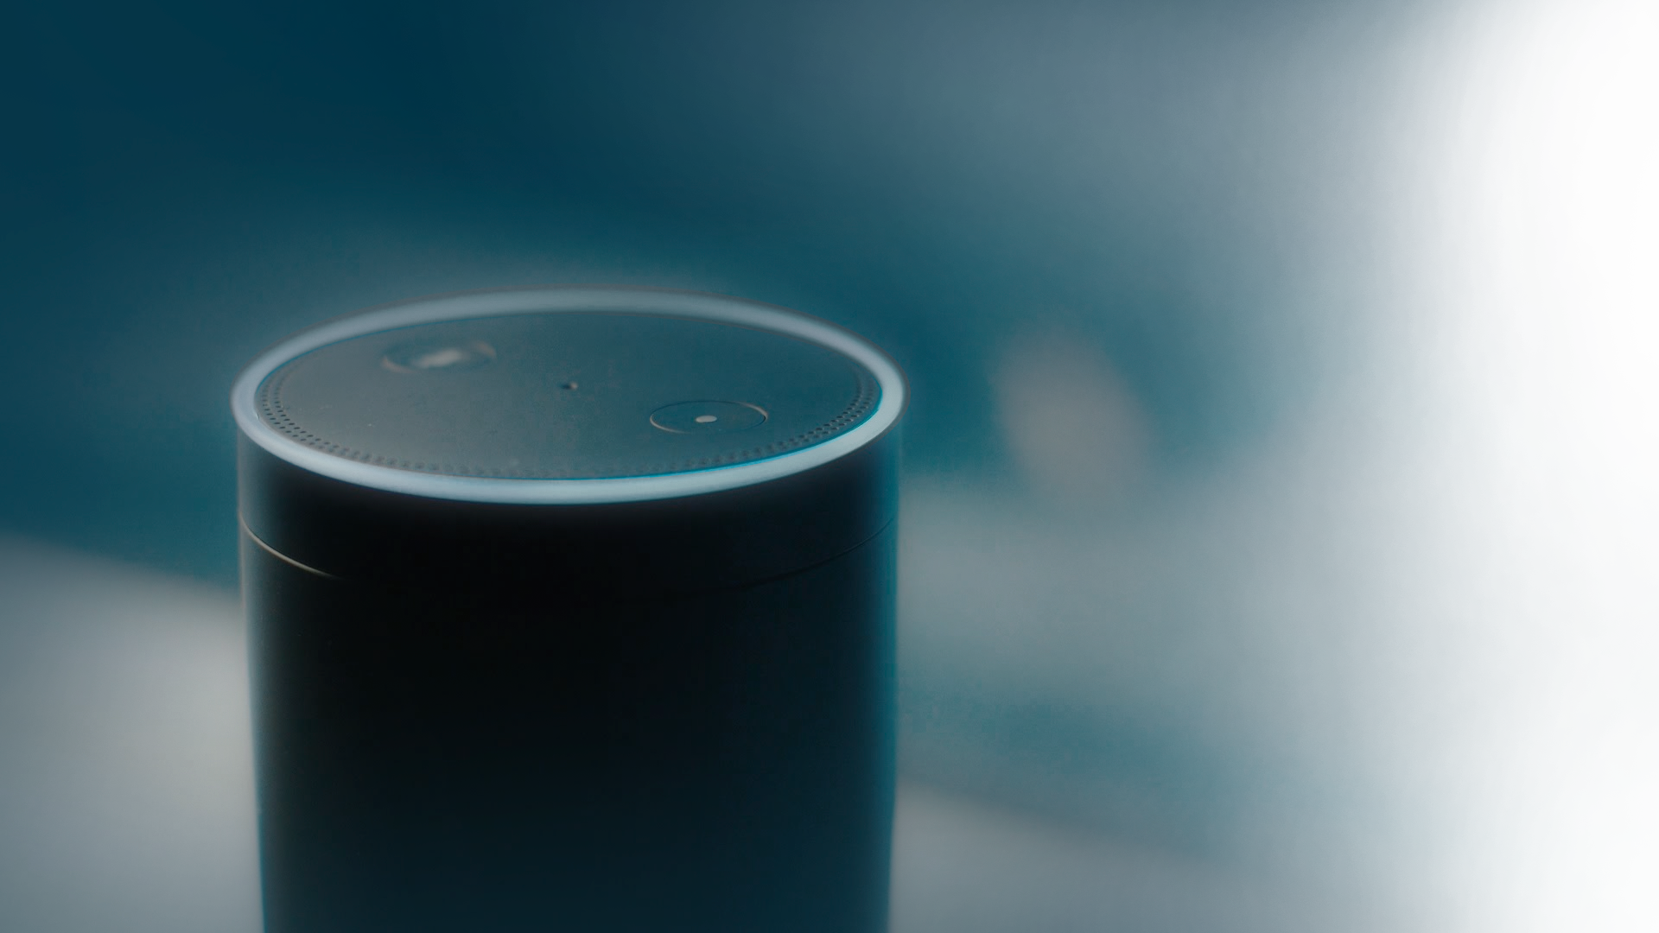
book a new appointment
Ok, I will book it for you
Could you please tell your identification number?

Slide 3
One thousand
Hello Guest, We have Doctors for One: Ear, Two: Tooth and Three: Eye.
Give me an appropriate number for the ailment you want to book appointment.

Slide 4
One
Doctor for Ear is available. Doctor having more than ten years of experience.
When do you want to book?

Slide 5
Ok, these are the times available on 21st of July: 9:00 AM, 10:00 AM, 11:00 AM, 12:00 PM, 2:00 PM, 3:00 PM, 4:00 PM
Tomorrow
Please tell your convenient time by responding with the time?

Slide 6
Your appointment for ear specialist is booked for 21st of July at timing from: 4:00 PM to 4:30 PM.
4:00 PM
Do you wish to create another appointment, respond with yes or no?

Slide 7
No
Thank You

Slide 8
Thank you

